Slide 1
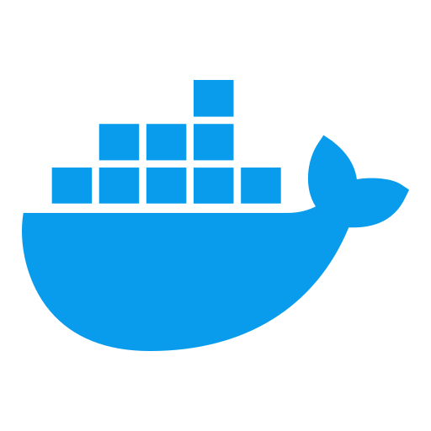
Docker & Containerization Workshop
Transforming Enterprise IT Through Containerization
By Dr Sohail Khan
Notes:
Comprehensive Docker & Containerization Workshop
Welcome to all participants
Brief introduction of instructors and their expertise
Workshop logistics and materials overview

Slide 2
Digital Transformation Landscape
Evolving Enterprise IT Requirements
Increasing deployment velocity demands
Infrastructure efficiency imperatives
Growing complexity of application ecosystems
Security and compliance challenges
Containerization as a Strategic Solution
Modern approach to application delivery
Foundation for cloud-native architecture
Enabler of DevOps and agile practices

Slide 3
Containerization Impact on Enterprise IT
Operational Efficiency
66% reduction in deployment time
40-60% improvement in resource utilization
50% decrease in infrastructure costs
Developer Productivity
Consistent environments across lifecycle
Elimination of "works on my machine" issues
Business Agility
Reduced time-to-market for new features
Enhanced service reliability and uptime

Slide 4
Container Adoption Trends
Industry Adoption
75% of global organizations now using containers in production
85% of IT leaders see containers as strategic technology
Kubernetes becoming de facto standard for orchestration
Government and Regulated Industries
Growing adoption in security-sensitive sectors
Standardization of infrastructure practices
Compliance and security benefits
Future Trajectory
Integration with serverless and edge computing
Standard component of modern IT architecture

Slide 5
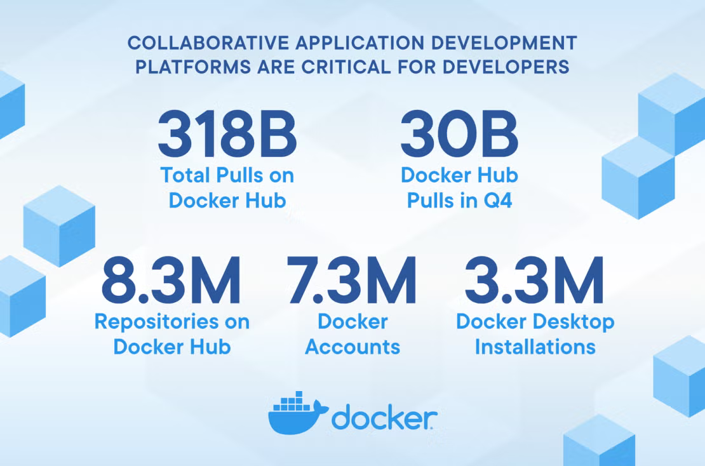

Slide 6
Workshop Objectives & Structure
Comprehensive Learning Journey
From containerization fundamentals to production deployment
Balance of theory and hands-on practice
Enterprise-focused implementation strategies
Three-Day Progression
Day 1: Containerization Foundations & Docker Essentials
Day 2: Container Customization & Application Implementation
Day 3: Multi-Container Orchestration & Production Deployment

Slide 7
Core Technical Focus Areas
Containerization Architecture
Container principles and design patterns
Docker ecosystem components
Image creation and optimization
Enterprise Implementation
Multi-container application design
Security hardening and best practices
Networking and data persistence strategies
Production Operations
Monitoring and observability
Backup and recovery procedures
CI/CD integration approaches

Slide 8
Hands-on Learning Approach
Progressive Skill Building
Each module builds on previous concepts
Practical application of theoretical knowledge
Real-world scenarios and challenges
Workshop Environment
Pre-configured tools and resources
Individual hands-on exercises
Collaborative problem-solving opportunities
Continuous Assessment
Regular knowledge checkpoints
Practical skill validation
Final implementation project

Slide 9
Organizational Benefits
Technology Standardization
Consistent deployment practices
Unified infrastructure approach
Reduced technology fragmentation
Strategic Capability Development
Modernization of application delivery
Enablement of cloud migration strategies
Foundation for digital transformation initiatives
Operational Excellence
Improved service reliability
Enhanced security posture
Optimized resource utilization

Slide 10
Implementation Roadmap
Post-Workshop Application
Pilot project identification
Containerization candidate assessment
Phased implementation strategy
Enterprise Integration Framework
Integration with existing systems
Security and compliance alignment
Operational readiness preparation
Long-term Evolution Strategy
Maturity model progression
Advanced orchestration adoption
Continuous improvement approach

Slide 11
Success Metrics & ROI
Quantifiable Benefits
Deployment frequency improvement
Infrastructure cost reduction
Mean time to recovery decrease
Developer productivity enhancement
Qualitative Outcomes
Improved cross-team collaboration
Enhanced technical capability
Greater architectural flexibility
Increased innovation capacity

Slide 12
Getting Started
Workshop Materials
Comprehensive manual and resources
Reference documentation and examples
Post-workshop support information
Participation Guidelines
Active engagement encouraged
Questions welcomed throughout
Practical application emphasized
Next Steps
Module 1: Virtualization to containerization Transition
Environment setup verification
Initial concepts overview

Slide 13

Questions?
Open floor for initial questions
Clarification on workshop structure
Introduction to first module instructor

